Slide 1
RegTech
Ken Liu

Slide 2




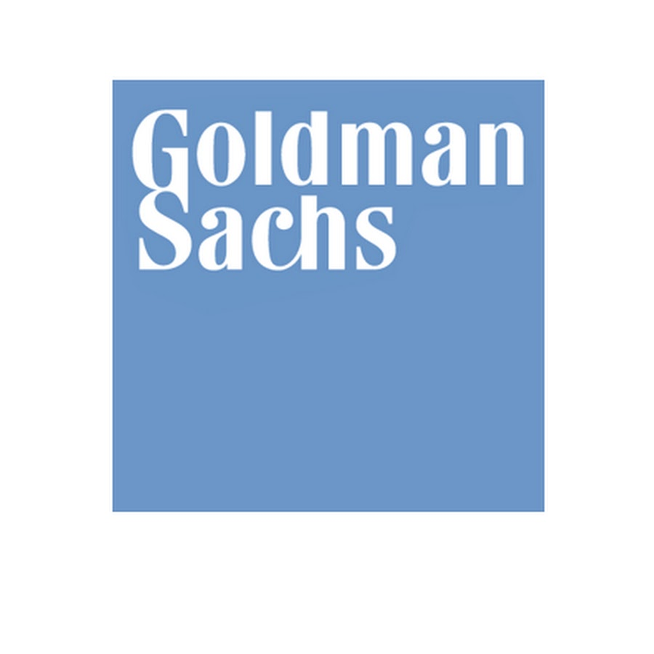

My Background
Study Computer Science
iBanks Algo trade technologist
Startup on Quant Trading, Big Data and AI
Email: wkliu_x@yahoo.com
LinkedIn: https://www.linkedin.com/in/ken-liu-76b11575/

Slide 3
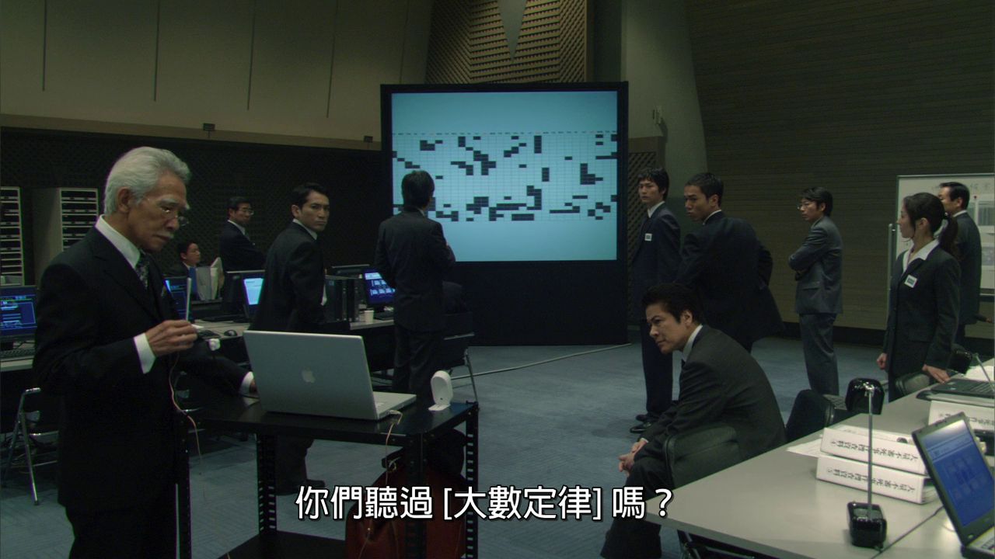
My Work
Sub-header/text/chart/table
“Have you heard of Law of Big Numbers”

Slide 4
Course Overview
RegTech Machine Learning case studies on numeric patterns Natural Language Processing and sentiment analysis Deep-Learning based OCR and image recognition for bio-metric security Reinforcement learning (game playing) in investment trading and related controls/regulations Generative (fake) contents
In-class assignment

Slide 5
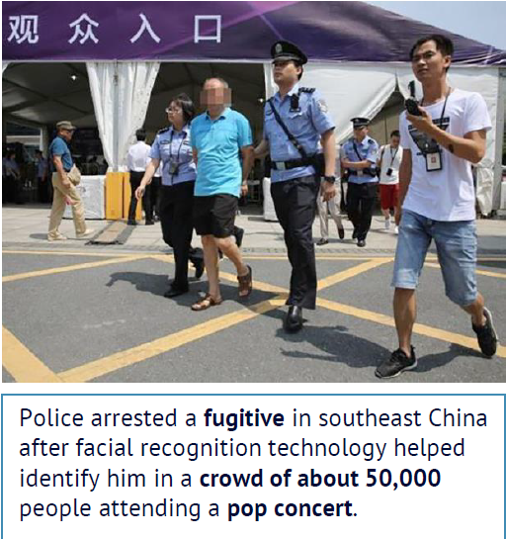
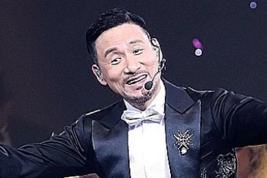
Introduction to AI - Third AI Boom (Now)
Machine Learning: a branch of AI and the key driver is (big) data from Internet, Mobile and IoT (Internet of Things which are sensors, smart devices etc.)
Example: 1.3 billions of faces in China, how can tell a computer to recognize a person?
# pseudo code
Color in {brown, yellow, black}
Has {hair, eye * 2, nose, mouth,
ear * 2 ……}
Eye: {black, white, brown ……..}
……………….
https://www.npr.org/sections/therecord/2018/05/23/613692526/thanks-to-ai-a-3rd-person-is-arrested-following-a-pop-superstars-concert

Slide 6
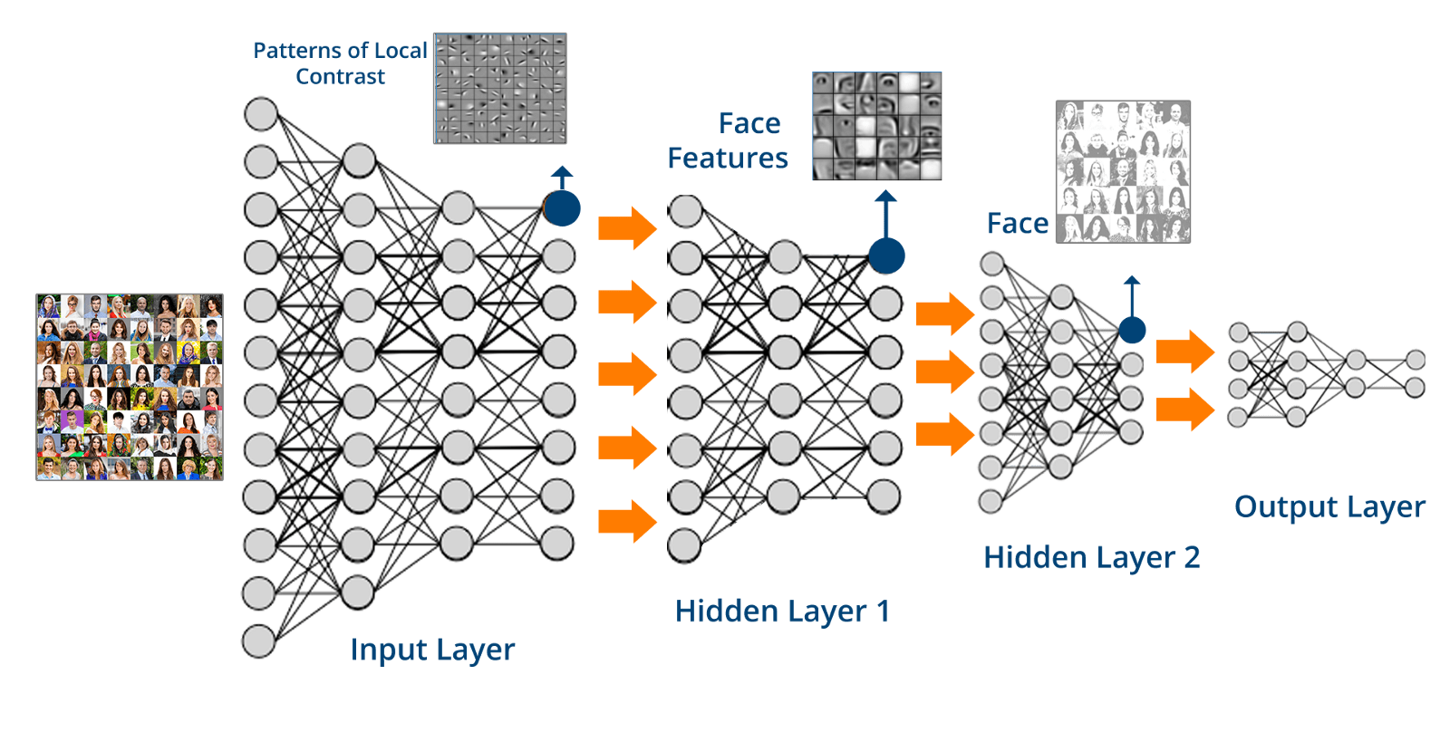
Machine Learning - Data
Learn from data rather than explicitly program the logic: let the computer see many examples (face, name) and learn how to represent it in a Deep Neural Network (brain-like structure)

Slide 7
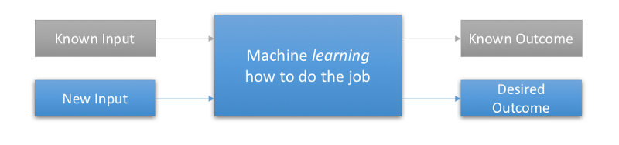
Machine Learning - Data
Supervised Learning: presented with example inputs and their desired outputs (labelled dataset), given by a "teacher“.
The goal is to learn a general rule that maps inputs to outputs (i.e. learn a function of y = x)

Slide 8

Machine Learning - Data
Where to find labelled dataset?
Freely source from the web
Kaggle Dataset
Google Dataset Search
AWS Open Data
Pay $
Human Data Labeler
Amazon Mechanical Turk
Datafarm.co ← (My friend’s startup)

Slide 9

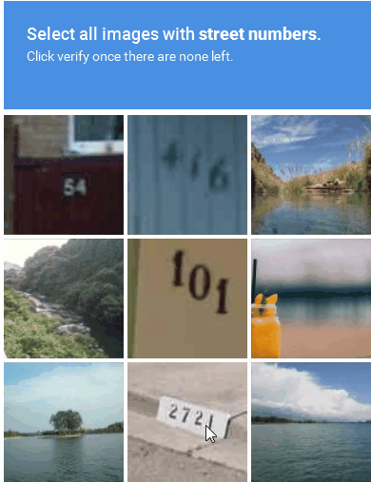
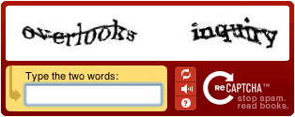
Machine Learning - Data
From YOU! (freely)
Where to find more labelled dataset?
Google reCAPTCHA

Slide 10
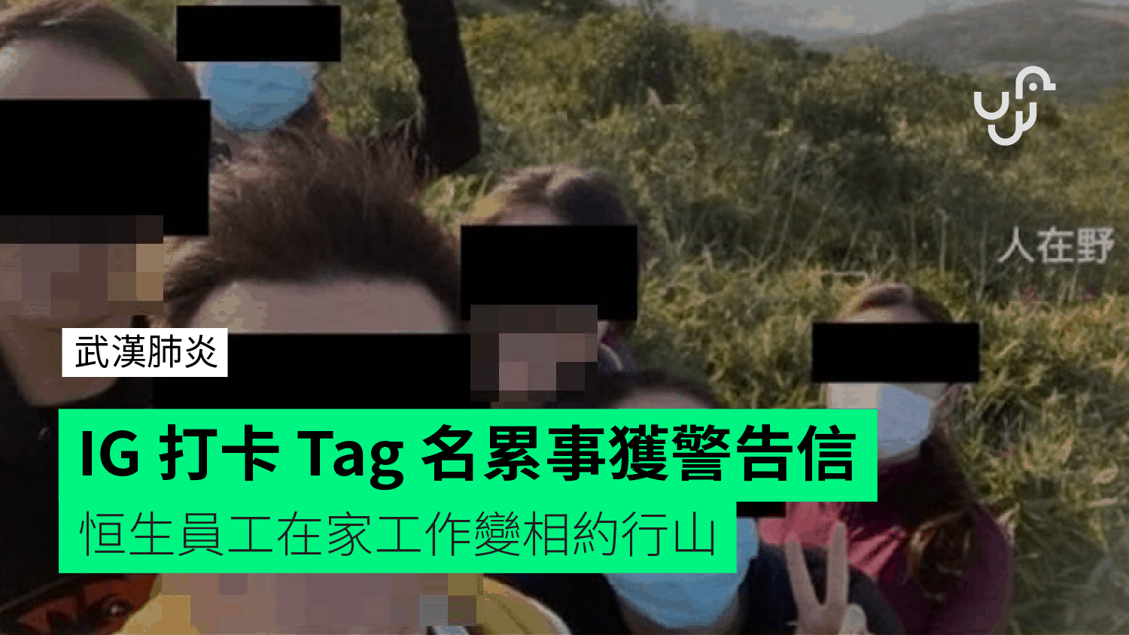
Machine Learning - Data
WFH (Work from Home Hill)
Tagged your friends in Facebook or IG

Slide 11
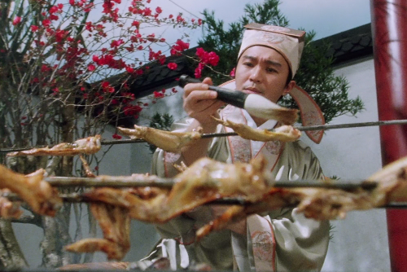
Machine Learning - GPU
IQ Test: Cook 1 chicken wing requires 10 mins. How many minutes for cooking 10 chicken wings?
Still 10 mins - cook chicken wings in parallel because each chicken wing is independent of each others
Compare to bank transactions which has to perform step-by-step
Supervised training is similar to cooking chicken wings as many labelled data in the dataset (e.g. face and name) is independent to each others
Notes:
Long nVidia is better than so many quant trades !

Slide 12
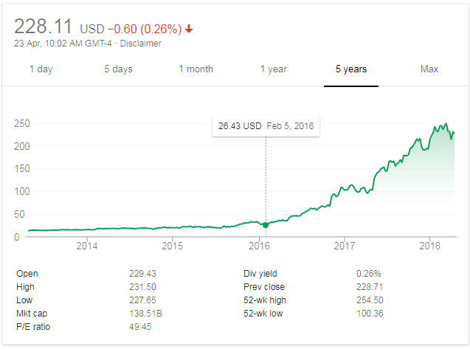
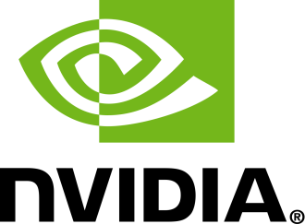
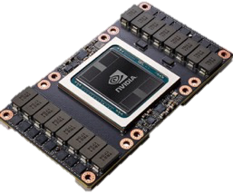
Machine Learning - GPU
Hardware Parallelization: GPU (Graphics Processing Unit) substantially improve the speed of calculation (nVidia stock price has gone up substantially)
Tesla V100 : 120 TFLOPS
One more usage: https://easyhashing.com/en/
Notes:
Long nVidia is better than so many quant trades !

Slide 13

Demo – Short Term Stock Price Prediction
Objective: Predict the directional (up or down) short term (next move) stock price movement based on historical data
Solution: Use Supervised Machine Learning with labelled data to do classification (up or down)

Slide 14
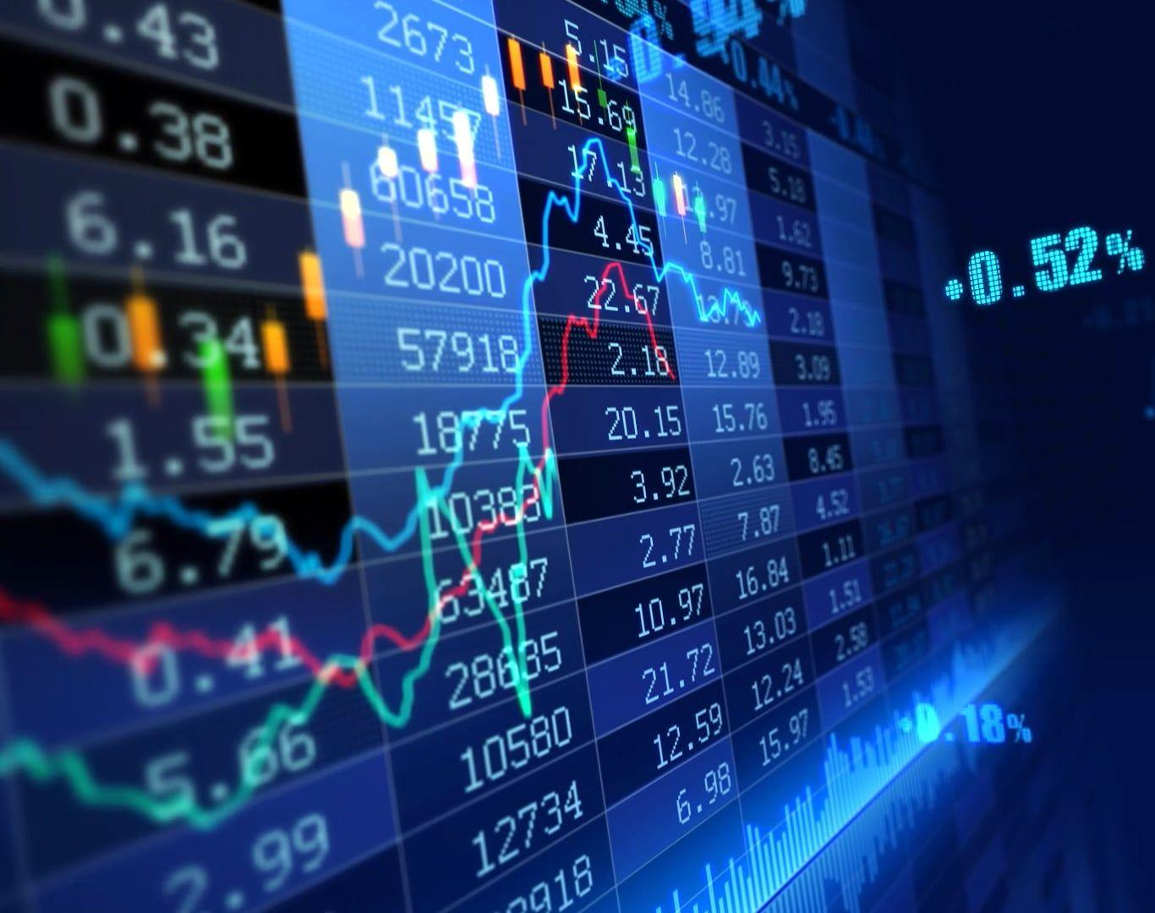
1. Raw Data – Historical Tick Data
Step 1: Get the raw source data
Free data from Yahoo Financial: the daily open/high/low/close/volume is not detail enough to predict the short term price movement
Need to purchase the very detail raw data (historical tick data) from the Hong Kong Stock Exchange

Slide 15
1. Raw Data – Historical Tick Data
https://www.hkex.com.hk/eng/ods/historicalData.aspx
Historical Full Book - Securities Market (CSV Format) provides information on every order and trade of Main Board and GEM stocks in CSV format. File is available on a daily basis, normally at around 10:00pm.
$5,000/Month
Historical Order Book and Statistics Update - Securities Market provides intra-day order book and statistics information recorded on the HKEX's Main Board and GEM stocks in CSV format. File is available on a daily basis, normally at around 10:00pm.
$2,500/Month

Slide 16
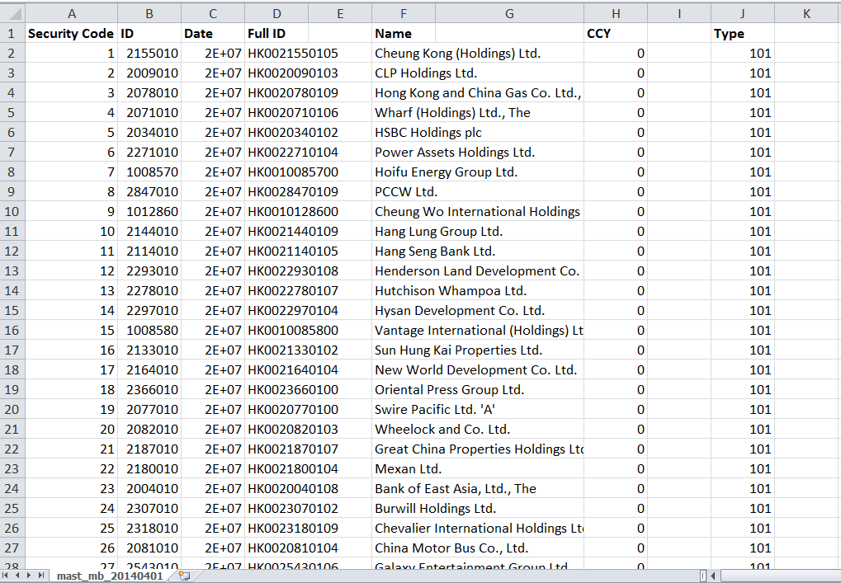
1. Raw Data – Historical Tick Data
Sample File: Security Information (Mainboard)

Slide 17
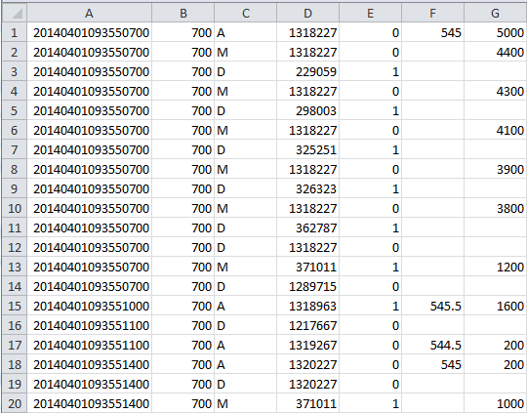
1. Raw Data – Historical Tick Data
Date/Time | Stock | Action | ID | Side | Price | Qty
Action (Order)
A: Add
M: Modify
D: Delete
Side
0 – Bid (Buy)
1 – Offer (Sell)
Sample File: 700.HK Raw Ticks

Slide 18
2. Pre-processed Data – Order Book
Step 2: Pre-process the raw data
Historical tick data, which contains the records of every order transactions, is too low level and not easy to extract the useful information for predicting stock price movement
Pre-process the tick data to Stock Order Book
Size | Bid | Ask | Size
74,000 | 152 | 152.1 | 81,800
54,000 | 151.9 | 152.2 | 33,100
80,800 | 151.8 | 152.3 | 34,100

Slide 19
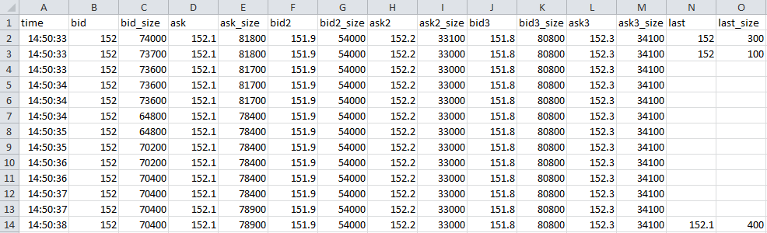
2. Pre-processed Data – Order Book
Sample File: 700.HK Order Book
Size | Bid | Ask | Size
74,000 | 152 | 152.1 | 81,800
54,000 | 151.9 | 152.2 | 33,100
80,800 | 151.8 | 152.3 | 34,100
Last Trade Price=152, Size=300

Slide 20
3. Feature Engineering
Step 3: Feature Engineering
Choose the “factors” to explains the outcome
In our case: choosing the factors to explain the stock price going up or down from the pre-processed data (i.e. stock order book)
The “factors” are called differently by different people
Statisticians call it explanatory variables or independent variables
Data Scientist call it features
Traders calls it trading signals
The outcome is also called the target or dependent variable

Slide 21
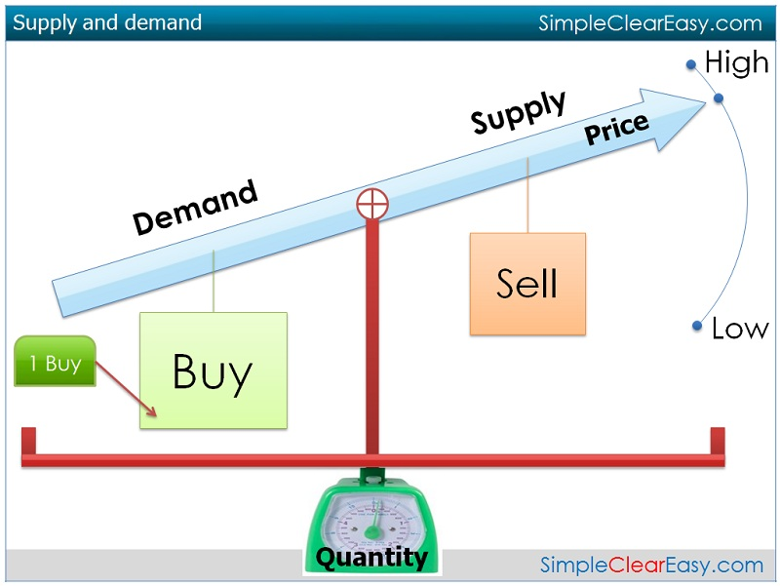
3. Data Feature - Order Book Imbalance
Order Book Imbalance: quantify supply vs demand. It’s the average ratio between the bid and ask size

Slide 22
3. Data Feature - Order Book Imbalance
Order Book Imbalance: the average ratio between the best bid and best ask size over a rolling 1-min window. If the average bid size is larger than the ask size (hence a positive ratio), like the example below, it indicates the price is more likely to go up. Vice versa, the price is more likely to go down.
1min-Order Book-Imbalance = Avg (Log(Best BidSize/ Best AskSize))
Options: We can take into account the first few levels (for example 3 levels) of the order book while the top level of the book will have higher weighting. The 1-min duration can also be customized to a shorter or longer duration.
Size | Bid | Ask | Size
100,000 | 152 | 152.1 | 20,000
400,000 | 151.9 | 152.1 | 550,000
200,000 | 151.8 | 152.3 | 80,000
Notes:
Ask why taking log – because the asymmetry of +ve and –ve ratio

Slide 23
3. Data Feature - Order Book Imbalance
Example (Assume the following order book numbers are 1-min average)
1min-Order Book-Imbalance = Avg (Log(Best BidSize/ Best AskSize))
First 1 Level: Log(100,000 / 20,000)
= 1.609 ← Positive when Bid Size > Ask Size (demand > supply)
First 2 Level: Log((100,000 + 400,000) / (20,000 + 550,000)) = Log(500,000 / 570,000)
= -0.13 ← Negative when Ask Size > Bid Size (supply > demand)
Size | Bid | Ask | Size
100,000 | 152 | 152.1 | 20,000
400,000 | 151.9 | 152.2 | 550,000
200,000 | 151.8 | 152.3 | 80,000
Notes:
Ask why taking log – because the asymmetry of +ve and –ve ratio

Slide 24
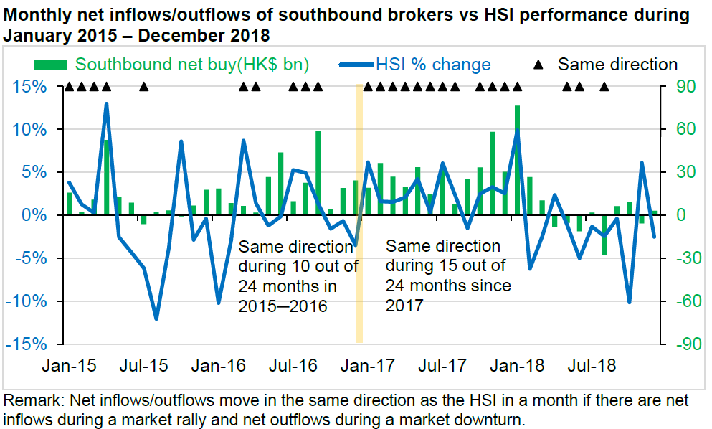
3. Data Feature - Money flow

Slide 25
3. Data Feature - Money flow
Money flow: when a stock is purchased at a higher price (i.e. Last > Previous Last), it is called uptick and be considered positive money flow. When the next trade is at a lower price (a downtick), this is considered to be negative money flow.
If more shares were bought throughout the 5-min window on the uptick than the downtick, net money flow is positive because more investors were willing to pay a premium for the stock.
5min-MoneyFlow = Σ( (Last – Previous Last) * Last Size)
Options: The 5-min duration can also be customized to a shorter or longer duration.

Slide 26
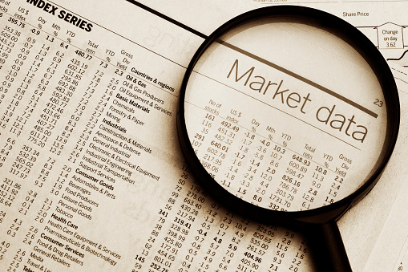
4. Labelled Dataset
Step 4: Prepare the labelled dataset for the Supervised Machine Learning Algorithm
Labelled Dataset: features -> outcome (target variable)
Features: order book features
Outcome: short-term (next) price move up/down
Generate labelled dataset from historical market tick data

Slide 27
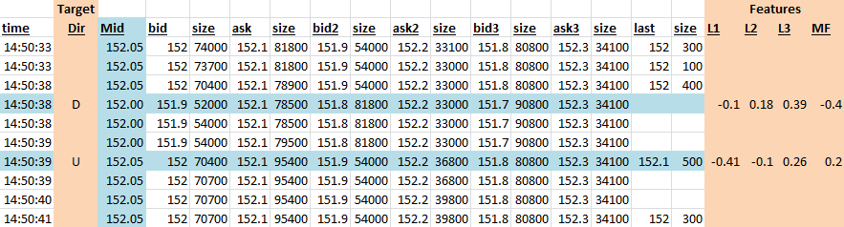
4. Labelled Dataset
Use historical market tick data (e.g. 1 week of Tencent). When there’s a price up/down change (the target variable), generate the corresponding order book features (e.g. Order- Book-Imbalance and Money-Flow)
* Price is mid-price which is (bid + ask) / 2

Slide 28
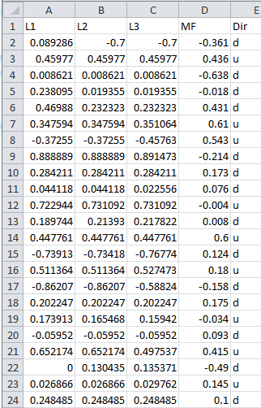
4. Labelled Dataset
L1: First-1-Level OBI
L2: First-2-Level OBI
L3: First-3-Level OBI
MF: Money Flow
Dir: Mid-Price Direction - u(up) , d (down)
Size | Bid | Ask | Size
100,000 | 152 | 152.1 | 20,000
400,000 | 151.9 | 152.2 | 550,000
200,000 | 151.8 | 152.3 | 80,000
The data normalized to [-1, 1]
Why Data Normalization is necessary for Machine Learning models

Slide 29
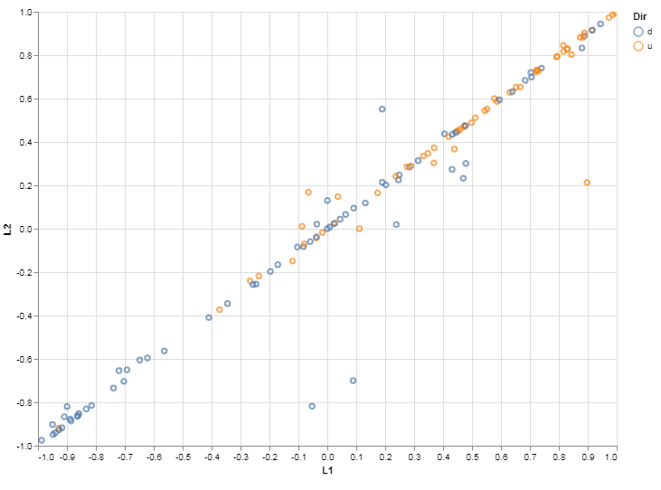
5. EDA (Exploratory Data Analysis)
Scatter Plot Order Book Imbalance (OBI)
Brown dots: stock going up
Blue dots: stock going down
Level-2 OBI
+ve OBI : Demand > Supply
-ve OBI : Demand < Supply
More Brown dots (up) when both Level-1 and 2 OBI are positive and vice versa
Visually confirm our intuition when Demand > Supply (+ve OBI), price tends to go up
Level-1 OBI

Slide 30
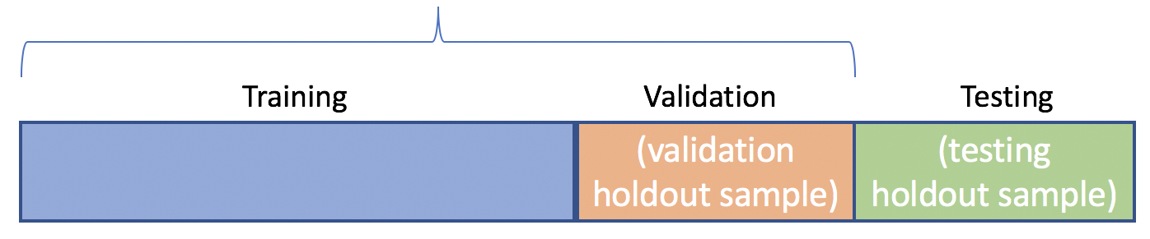
6. Machine Learning Dataset
Step 6.1: Split the labelled Dataset into Training, Validation and Testing
In-Sample
Training Set: the labelled data used to train the underlying model
Validation Set: set aside examples to tune the hyper-parameters
Test Set: the data set not seen by the model training and used only to assess the performance of a fully-trained model

Slide 31

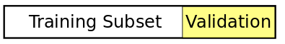
6. Machine Learning Dataset
Validation Set
Holdout Validation: reserve certain % of the training data as validation set. Recommend for large data sets.
Cross Validation: partition the data set to n-fold. Trains a model using the out-of-fold observations. Assesses model performance using in-fold data and calculates the average test error. Recommend for small data sets.

Slide 32

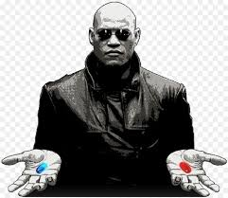
6. Machine Learning Algorithm – Decision Tree
Step 6.2: Choose a Machine Learning Algorithm that suitable for your dataset and objective

Slide 33
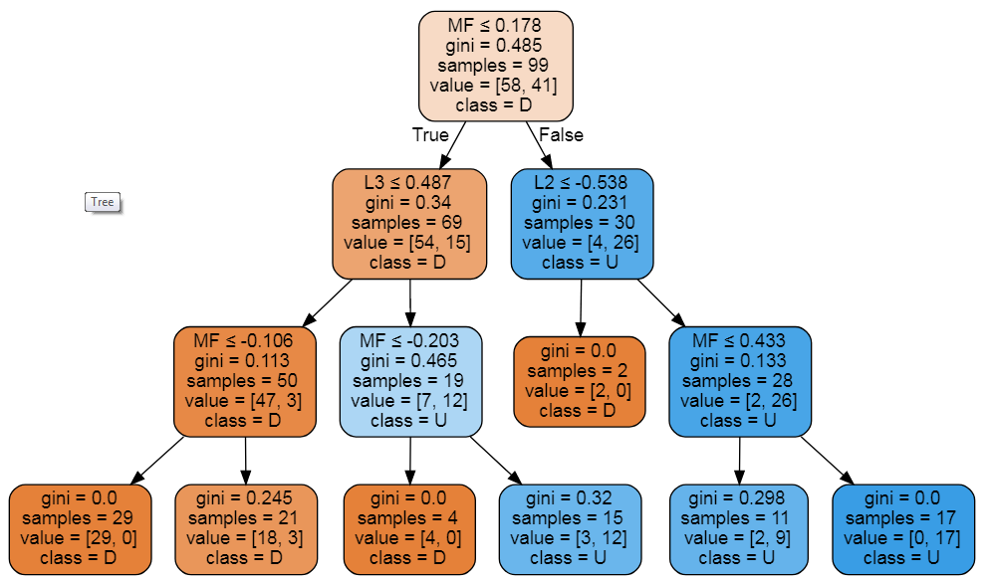
6. Machine Learning Algorithm – Decision Tree
Left branch = True
Right branch = False
gini quantifies the purity. The lower is better (as indicated by a darker color)
Down class is orange
Up class is blue
Code Example
Down: MF<=0.178 and L3<=0.478 and MF<=-0.106
Up: MF > 0.178 and L2 > -0.538 and MF > 0.433
Down: L3<=0.478 and MF<=-0.106
Up: L2 > -0.538 and MF > 0.433
Stay: Other than the above

Slide 34
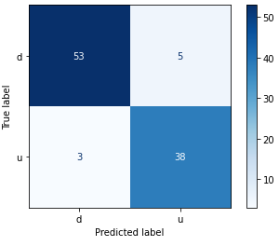
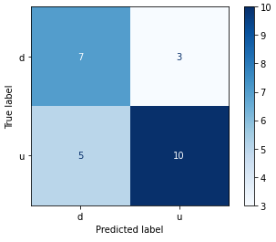
7. Performance - Evaluation
Training
Testing
Training vs Testing Accuracy
92% vs 68%
Testing accuracy is a lot lower and what’s that imply?
Is 68% good enough for trading?

Slide 35
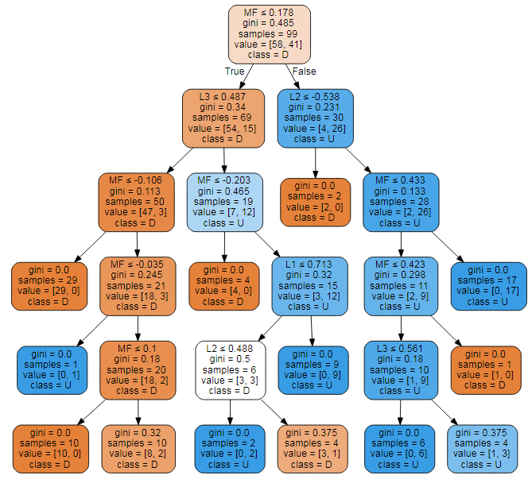
7. Performance - Evaluation
Training Accuracy = Low, Testing Accuracy = Low
How to increase the training accuracy ?
Increase model capacity. For example increase the tree depth in our decision tree example
dtree = tree.DecisionTreeClassifier(max_depth=5)
This usually increase the training accuracy. If the testing accuracy is not increased accordingly, it’s called overfit

Slide 36

7. Performance - Evaluation
Training Accuracy = High, Testing Accuracy = Low
How to increase the testing accuracy ?
It is something to do with the data
Add more data (rows) to learn enough variations and/or
Add/change the dataset features (columns). Features engineering the related data

Slide 37
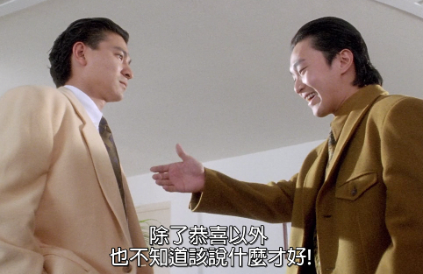

7. Performance - Evaluation
Training Accuracy = High, Testing Accuracy = High

Slide 38
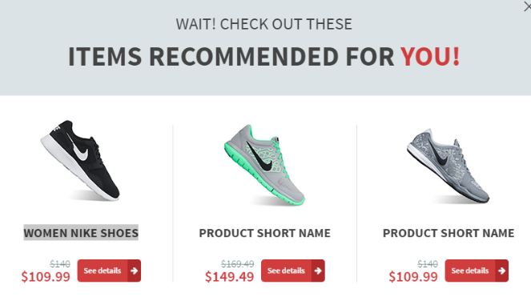
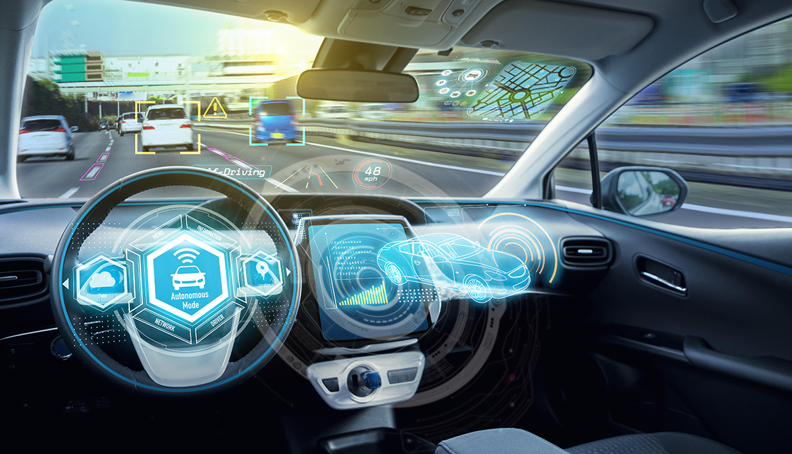
7. Performance - Accuracy
How much accuracy is enough: 70%, 80%, 90%, 99% ??
It depends on the applications. Self driving cars require much higher accuracy than the product recommendation system.
Trading and investment predictions are generally not very high in accuracy.

Slide 39
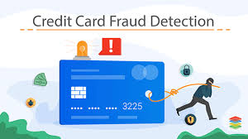
7. Performance - Accuracy
Accuracy vs Specificity
Example: Credit Card Fraud detection system (fraud is an anomaly event that happen only 1% in the dataset). If the system is able to predict Fraud or “No Fraud” in 99% accuracy, do you think it is good enough?
NO, a dumb system that always predict “No Fraud” will achieve 99% accuracy. Need to look specifically at the accuracy of the “Fraud” cases (specificity).

Slide 40
8. Trained Model Usage
The model predicts the stock price will go up for the next move, hence Buy it now @ $152.1
Size | Bid | Ask | Size
74,000 | 152 | 152.1 | 81,800
54,000 | 151.9 | 152.2 | 33,100
80,800 | 151.8 | 152.3 | 34,100
Size | Bid | Ask | Size
80,000 | 152.1 | 152.2 | 33,100
74,000 | 152 | 152.3 | 34,100
54,000 | 151.9 | 152.4 | 43,000
The stock price did go up as predicted, hence Sell it now @ $152.1
Lose all the profit from bid/ask spread, also pay the transaction costs

Slide 41
8. Trained Model Usage
The “short term price prediction” alone probably cannot be a profitable strategy by itself. However, it can be a sub-module to improve certain aspect of other strategies
Trading Strategies – HK Warrant Follow the Super Trader
Enter Trade when "super user" trade (when a single trade of notation greater than certain amount on a warrant and ask price move up (>= 1 tick) within 10ms to 5s
Exit Trade in these 3 modes
1: Profit mode: Sell if best bid + 2 ticks >= avg px
Improve Profit Mode by “Short Term Price Predictor”
wait a bit longer if the warrant underlying stock price is predicted to go up. Take profit sooner if price going predicted to go down

Slide 42

Support Vector Machine (SVM)
A classifier formally defined by a separating hyperplane.
The goal is to find the hyperplane that gives the largest minimum distance to the training examples. Therefore, the optimal separating hyperplane maximizes the margin of the training data (those data points in solid color that formed the maximum margin are the support vectors)
YouTube: SVM separate complex dataset

Slide 43

Support Vector Machine (SVM)
Nonlinear classification performed by applying kernel transformation
Transform to higher dimension space
(Notes: Statistical significance, Curse of Dimensionality)

Slide 44
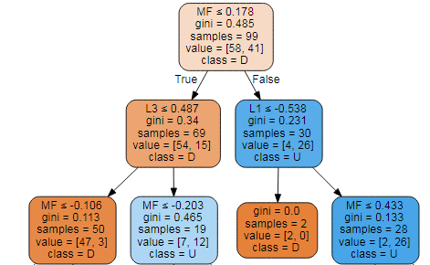
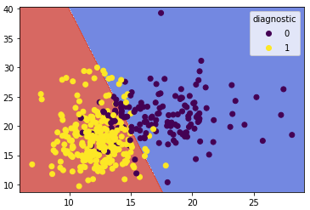
Model Interpretability
Decision Tree
Support Vector Machine
If Decision Tree and Support Vector Machine has similar training time and test accuracy, which model to choose?
Decision Tree is more interpretable

Slide 45
Conclusions and Takeaways
Supervised ML (Machine Learning) is data driven and thus the data is the most important component. Spend most of the time (~80%) in sourcing, cleaning, pre-processing the data to useful features
GIGO (Garbage In Garbage Out). No matter how powerful is the ML model, if the data is not relevant, the results will not be good.
The ML models are generic and they learn the knowledge from the data (e.g. use decision tree with TA features such as SMA, RSI for longer time horizon price trend prediction). Hence it requires Domain Knowledge to formulate the right dataset and features in many applications.
The ML models learn the relationship between the input features and the target. If there are rules or formulas between them, no need to use ML. If the input and target relationship doesn’t exist, the Model may still try to learn a “over fit” relationship.

Slide 46
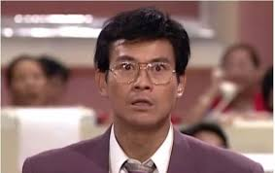
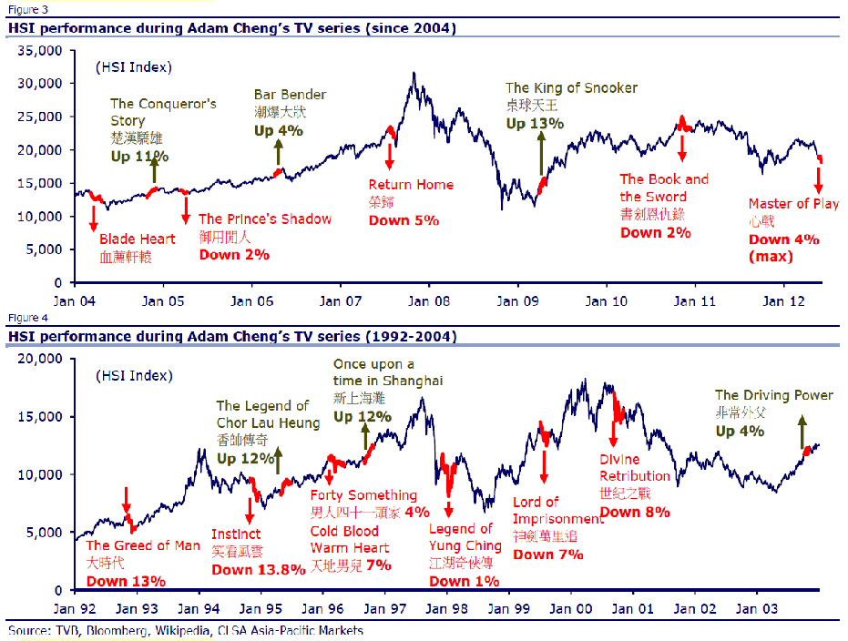
Sentiment Analysis
丁蟹效應 / Ting Hai Effect
Notes:
e.g. People over worry about the typhoon coming and insurance stocks are too over-sold

Slide 47
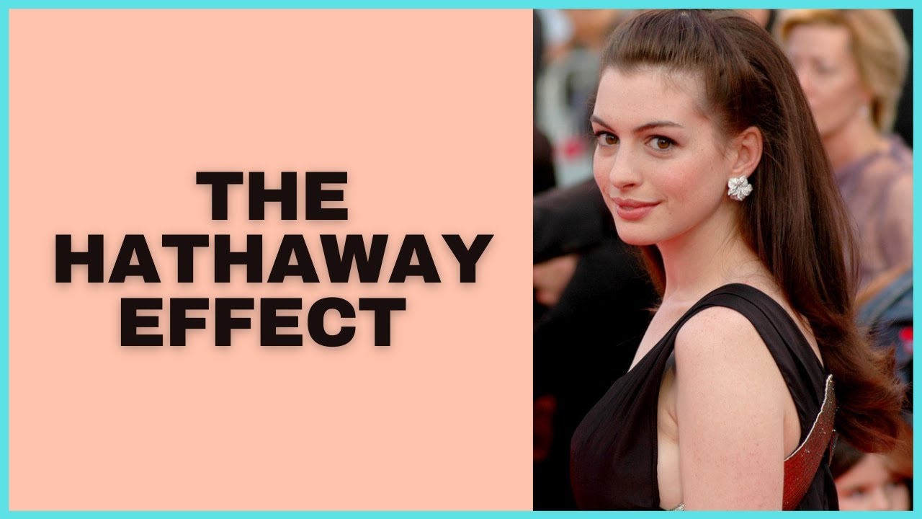
Sentiment Analysis
The Hathaway Effect stipulates that when Anne Hathaway is in the news, the share price for Warren Buffett's company Berkshire-Hathaway goes up
Notes:
e.g. People over worry about the typhoon coming and insurance stocks are too over-sold

Slide 48
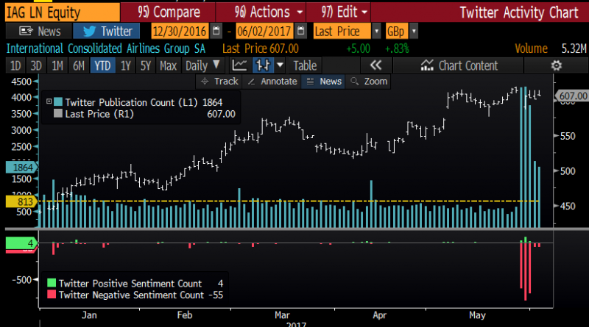
Social Media Sentiment vs Stock Price
Social media ramp-and-dump scam
A social media ramp-and-dump scam is a form of stock market manipulation where fraudsters use different means to “ramp” up the share price of a listed company and then induce investors via social media platforms to purchase the shares they “dump” at an artificially high price
Code Example: Twitter and stock price correlation

Slide 49
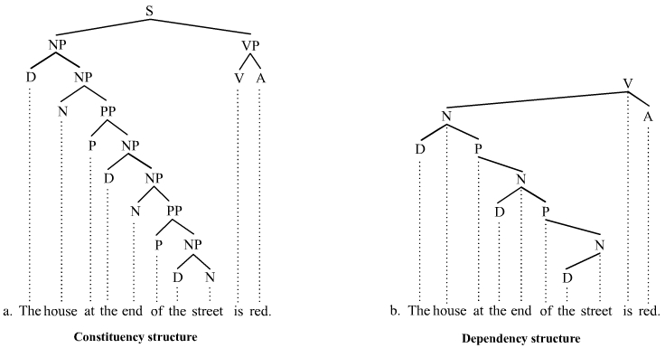
Natural Language Processing (NLP)
Treebanks
Example: Stanford Sentiment Treebanks
Code Example: NLP
Notes:
Corpus, Treebank: manually prepare a lot data

Slide 50
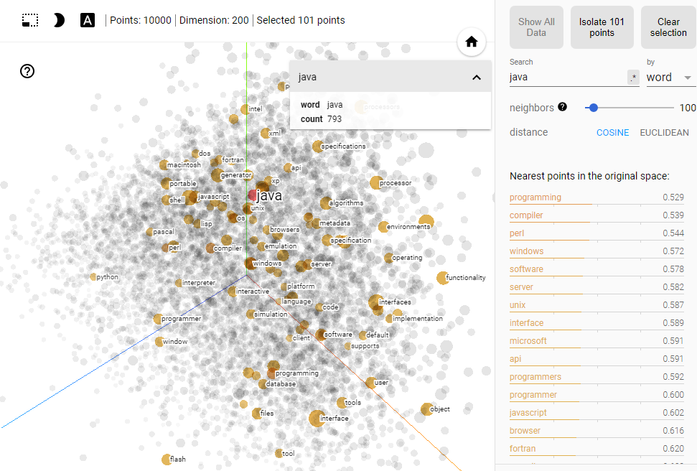
Word2Vec
Code example of Word2Vec
Interactive Demo

Slide 51
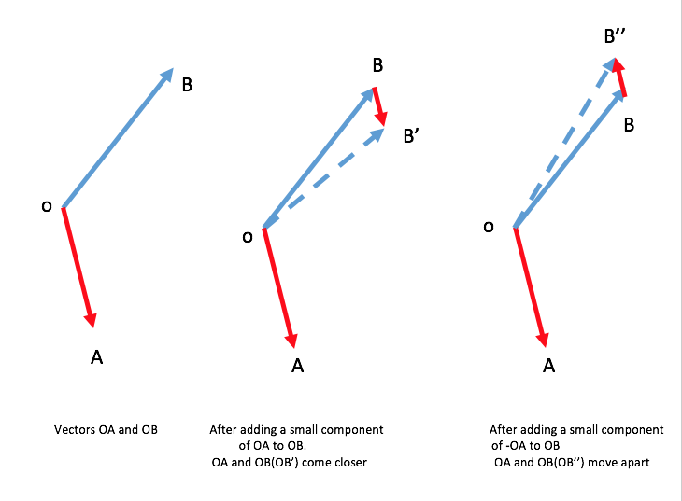
Word2Vec – Definition
Example: Mary is a very stubborn child. Her pervicacious nature always gets her in trouble: pervicacious is surrounded by stubborn, nature, and trouble.
Context: a fixed number of words in front of and behind the word of interest. Learns the meaning of a given word by looking at its context and representing it numerically.
“a word is characterized by the company it keeps - John Rupert Firth”

Slide 52
Word2Vec – Definition
Skip-Gram Training data (Window = 2):
I would like to go someplace nearby for lunch
Input | Output
go | like
go | to
go | someplace
go | nearby
Input | Output
someplace | to
someplace | go
someplace | nearby
someplace | for
The Illustrated Word2vec
An example of unsupervised learning with abundant free text from the Web but beware of Gender Bias of Word Embeddings

Slide 53
Word2Vec – Similarity
JPMorgan Equity Research Report 2007 - 17
most_similar('car')
[('cars', 0.5899946093559265),
('vehicle', 0.5460749864578247),
('vehicles', 0.455700546503067),
('auto', 0.38780486583709717),
('suv', 0.3466867208480835),
('minivan', 0.3353206515312195),
('truck', 0.31946268677711487),
('minicar', 0.3166467249393463),
('home', 0.314445436000824),
('bike', 0.3133225739002228)]
most_similar('risk')
[('risks', 0.5921677947044373),
('probability', 0.4140169024467468),
('likelihood', 0.3951364755630493),
('possibility', 0.3811781406402588),
('uncertainty', 0.34543055295944214),
('challenge', 0.322320818901062),
('concern', 0.288372278213501),
('uncertainly', 0.2852689027786255),
('odds', 0.271675169467926),
('threat', 0.2695636749267578)]

Slide 54
Word2Vec – Dissimilarity
JPMorgan Equity Research Report 2007 - 17
doesnt_match('revenue tax sales income'.split())
Out: 'tax'
doesnt_match('apple samsung microsoft'.split())
Out: 'microsoft'
doesnt_match('apple ibm microsoft'.split())
Out: 'apple'
doesnt_match('car pe pb growth'.split())
Out: 'car'

Slide 55
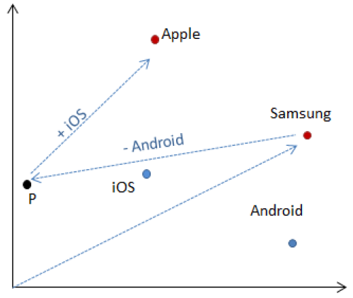
Word2Vec – Addition and Subtraction
JPMorgan Equity Research Report 2007 - 17
most_similar(
positive=['samsung', 'ios'],
negative=['android'])
[('apple', 0.35112401843070984)]

Slide 56
Word2Vec – Corpus comparison
JPMA | Google News
Driver
contributor | drivers
drivers | Driver
catalyst | motorist
determinant | driving
culprit | car
beneficiary | motorcyclist
determinants | wheel
differentiator | Drivers
detractor | truck
contributors | vehicle
JPMA | Google News
overweight
neutral | Overweight
ow | underweight
underweight | obese
uw | morbidly_obese
constructive | obesity
cautious | Underweight
selective | severely_obese
pt | metabolic_syndrome
intact | waist_circumference
bullish | BMI

Slide 57
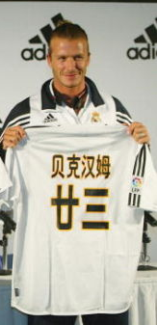
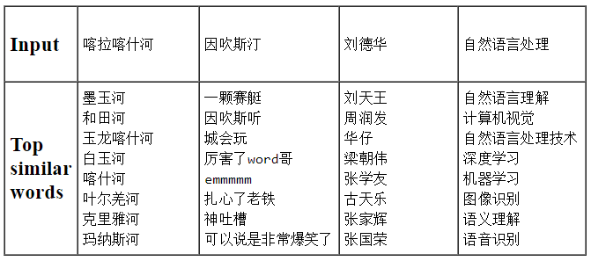

Word2Vec – Chinese Language
Tencent AI Lab Embedding Corpus for Chinese Words and Phrases
Training Data: News, Webpages, Novels, Wikipedia and Baidu Baike
Wechat ?

Slide 58
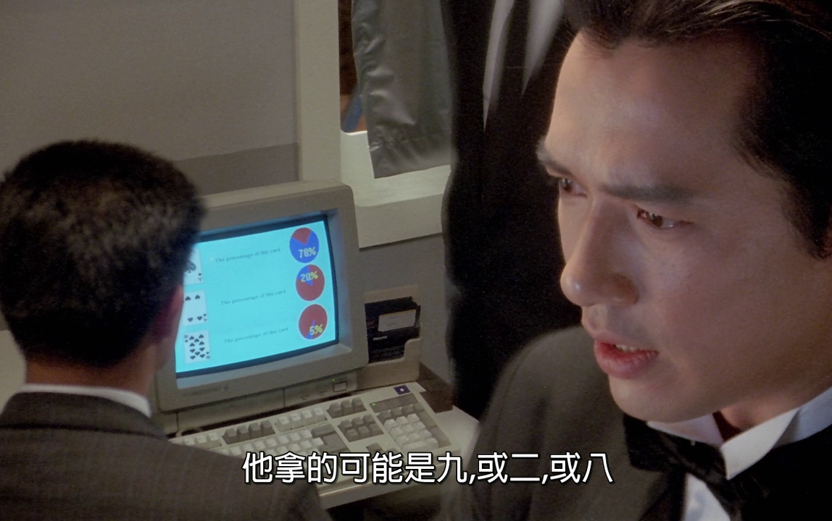
Demo: Image Classification

Slide 59
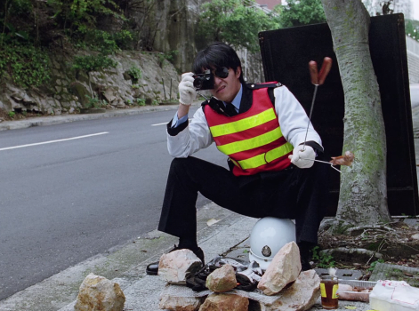
Demo: Image Classification
Recognize car license plate from the photos
My classmate spent 6 months in his final year project back in 2000 which involve image processing (edge detection) and describe all the shapes
Speeding

Slide 60
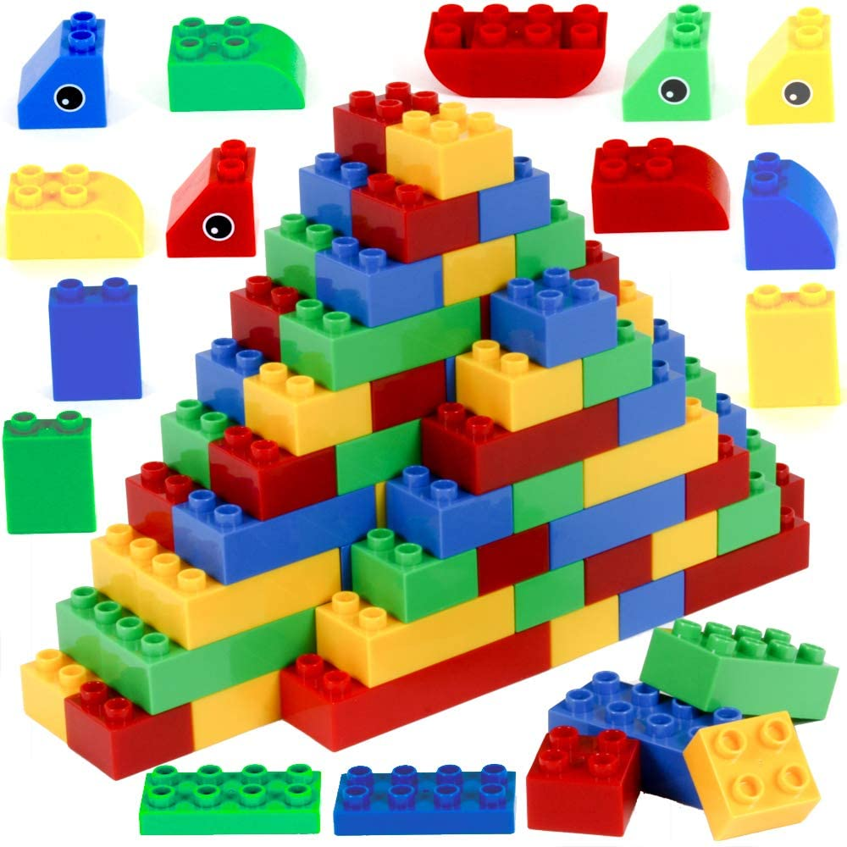
Deep Learning - Neural Networks
Think of Neurons as a Lego building blocks.
They can connect together to form many different shapes

Slide 61
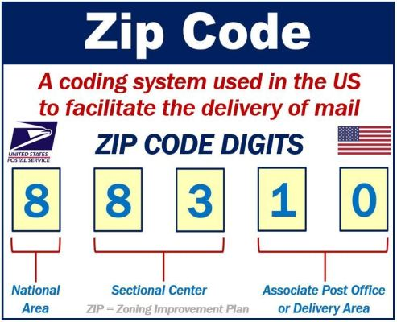

Demo: Image Classification
Recognize hand-written zip code and route the mails accordingly
Code Example: Digits Classification

Slide 62

Deep Learning – CNN

Slide 63

CNN Use Cases - Satellite image
Oil reserves are often stored in floating tanks around the world, whose lid rises and falls with increasing or decreasing storage. With the rising and falling height, the crescent-shaped shadows cast by the sun also change shape. By tracking these shape changes (Deep Learning - CNN), Orbital Insights predicts oil inventory levels. https://www.wired.com/2015/03/orbital-insight/

Slide 64


Use Cases – Face Recognition
化妝就係你落咗妝，我仲認得你，你落咗妝，我唔認得你，嗰啲叫做喬裝。
If you can still unlock FaceId, it’s called make-up, otherwise it’s a “fake-up”
上咗妝後 FaceId 仲認得叫做化妝，認唔到嘅叫做喬裝

Slide 65

Use Cases – Face Recognition
Face recognition: wrongful arrests
May 2019: Detroit police arrested Michael Oliver (right) after a facial recognition algorithm incorrectly matched him with a cellphone video. Oliver has tattoos on his arms which were not present on the person captured on video (left)
January 2020: Detroit police arrested Robert Williams after a similar algorithm incorrectly matched the photo on his driver's license with blurry CCTV footage.
Source: stateof.ai 2020
California Becomes Third State to Ban Facial Recognition Software in Police Body Cameras
A new US bill would ban the police use of facial recognition

Slide 66



Use Cases – Face Recognition
Limitation of Face Recognition – people wearing masks or with paintings
With painted faces, artists fight facial recognition tech
How to send Winnie-the-Pooh

Slide 67

Use Cases – People Recognition
Surveillance camera technology that can recognize you just from how you walk
Where is the labelled training dataset (Walking Style -> Name) coming from?
Shops: electronic payment + shops cameras
Security check: in airports, train stations when pass through the security gate
Name-registered phone (China): named-phone GPS + street cameras

Slide 68


Discussions – Privacy Concern

Slide 69


Before AlphaGo
Do I need to be a good chess player to write a good chess game?

Slide 70

Before AlphaGo
No need. Computer just evaluate the game tree. Advanced Level means evaluating more level at each steps. Moreover, towards the end game, computer becomes faster (as fewer steps to evaluate) while human players tends to spend more time to think of each of steps carefully.
Game Search Tree

Slide 71

Before AlphaGo
Key Points: State-Space (Complete Information and deterministic), Search Tree (Brute-force, Heuristic, Adversarial), Goal (Score, Weighting)

Slide 72

AlphaGo

Slide 73



AlphaGo
https://cs.stanford.edu/people/karpathy/convnetjs/demo/rldemo.html
Tunneling !

Slide 74

Reinforcement Learning
Software agents to take actions in an environment so as to maximize some notion of cumulative reward to achieve the objective.
The feedback (rewards or punishments) can be delayed.
Explore vs. Exploit: should the algorithm explore new alternative actions that may maximize the final reward, or stick to the established one that maximizes the immediate reward.

Slide 75

Reinforcement Learning
State | Action | Reward
 | Left | Score: 100, Life: 5
 | Right | Score: 101, Life: 5
 | Stay | Score: 101, Life: 4
….. | … | …
….. | … | …
….. | … | …
Like chess, in theory, we can list all the possible states (every pixel combinations), actions and rewards. Then choose the sequence of the actions that leads to the best rewards.
What are the draw backs?
Require large storage to store the tables and computing time to evaluate the steps
Not all states are valid
Very time-consuming to prepare such dataset

Slide 76


Deep Reinforcement Learning
Just play the game and record each frame (state) and action as the input and the corresponding reward as the output
Each frame is just an image and hence train CNN (Convolutional Neural Network) to approximate the input images (states and actions) to the output rewards relationships
Supervised Learning learns Relationship (Classification / Regression); RL learns Policy (Strategy)
Key Idea: Deep Learning + Reinforcement Learning = Deep Reinforcement Learning

Slide 77

Deep Reinforcement Learning
This method is very generic and can apply to many different games: Code Demo
Source: A Survey of Deep Reinforcement Learning in Video Games

Slide 78

Deep Reinforcement Learning
This method is very generic and can apply to many different areas

Slide 79


Deep Reinforcement Learning on Trading

Slide 80

Deep Reinforcement Learning on Trading
JP Morgan LOXM
Learns to perform the best action (choose optimal price, duration and order size ) based on market conditions
State: price series, spread cost, fill probability, size placed, elapsed time, %progress
Rewards: immediate rewards (price spread) and terminal (end of episode) rewards like completion, order duration and market penalties (negative rewards that punish the agent)

Slide 81


Deep Reinforcement Learning on Trading
AI Traders -> Repeatedly Doing Backtest -> Find the Optimal Strategies
It is a very black box approach and may not be welcomed by compliance and regulators

Slide 82
Deep Reinforcement Learning on Trading
HKMA : High-level Principles on Artificial Intelligence
Board and Senior Management accountable for the outcome of AI applications
Possessing sufficient expertise
Ensuring an appropriate level of explainability of AI applications
Using data of good quality
Conducting rigorous model validation
Ensuring auditability of AI applications
Implementing effective management oversight of third-party vendors
Being ethical, fair and transparent
Conducting periodic reviews and ongoing monitoring
Complying with data protection requirements
Implementing effective cybersecurity measures
Risk mitigation and contingency plan

Slide 83
Exchange and Rules – Price Range
Price range: the max and min trading price of a stock
Market
Hong Kong | Quotation Rule: Order price not away more than 24 spreads from nomimal price in Cont Trading; +/- 24 in Auction
Taiwan | 10% from close
China | 10% from close
Singapore | 10% from close
Korea | 15% from close
HK uses dynamic price range which is the most difficult to program and monitor

Slide 84

Exchange and Rules - Volatility
Volatility Control Mechanism (VCM): prevent or control the extreme volatility and provide cool down period: https://www.hkex.com.hk/vcm/en/index.htm

Slide 85
Error & Risk Control
SFC reprimands and fines Sun Hung Kai Investment Services Limited
Fined $1.5 million for internal control failures relating to an erroneous buy order for two billion shares of China Life. On 8 September 2011, an account executive of SHKIS received an order from a client to buy 25,000 shares of China Life at $18.82. The account executive, however, mistakenly inputted “2,500,018,000” shares as the order quantity. The dealing system of SHKIS automatically split the erroneous order into 834 smaller orders which were then sent to the market
SFC reprimands and fines Credit Suisse (Hong Kong) Limited
Fined a total of $39.3 million for regulatory breaches, including failures in segregating client securities, reporting direct business transactions, complying with short selling requirements
SFC reprimands and fines Interactive Brokers
Fined $4.5 million for its execution of market orders using electronic and algorithmic trading systems. The SFC’s disciplinary action followed two market disruption incidents in 2015 and 2016 where the share prices of Hong Kong-listed O-Net Communications (Group) Limited and AAG Energy Holdings Limited were ramped up by 48.7 per cent and 126 per cent, respectively, in less than two minutes.

Slide 86
Error & Risk Control
Fat Finger Limit (FFL): set the max quantity & notional, price deviation to catch unrealistic inputs due to extreme market conditions, human typos or erroneous setup
Price Impact: snap a starting reference price and set the Algo trading price range (usually in steps of 3%, 5%, 10% etc.)
Prevent Own Execution: For certain Algos (Market Making), Buy/Sell price can never been crossed as it will lead to executions. This may be deemed as creating fake transactions
Order Monitoring: order overfill; order pending for too long (e.g. connection lost)

Slide 87
Error & Risk Control
Prevent order flashing
Size | Bid | Ask | Size
10,000 | 152 | 152.1 | 20,000
40,000 | 151.9 | 152.1 | 50,000
20,000 | 151.8 | 152.3 | 80,000
Algo logic calculates a theoretic price to buy 1M shares at 152.000322
Market rules rounds it down to a valid tick size at 152 and send this price to the exchange
Size | Bid | Ask | Size
1,010,000 | 152 | 152.1 | 20,000
40,000 | 151.9 | 152.1 | 50,000
20,000 | 151.8 | 152.3 | 80,000

Slide 88

Error & Risk Control
Senior Management request to get rid of all these bugs in the Algo logic
Transactions count
In the risk control layer, limit the numbers of repeated cancel/resend with same price and quantity per minute
Dynamic zero (bugs)
動態清零

Slide 89

Error & Risk Control
Environment Segregation: Development, QA (testing) and production environment needs to be separated properly
耶穌都留佢唔住 我話嘅
Even Jesus cannot save you
Developer send a test order to production (real exchange) could become a major disaster

Slide 90

Generative Text
Talk to Transformer
Chinese Novel Generation
GPT-2 Language Model
Trained to predict the next word in 40GB of Internet text. It is a large transformer-based language model with 1.5 billion parameters, trained on a dataset of 8 million web pages.
GPT-3
175 billion parameters
Demo: GPT-3-powered business idea generator

Slide 91

GANs (Generative Adversarial Networks)
StyleGAN: Which face is real ??
AI Creates Fashion Model with Custom Outfits and Poses
Other GANs Applications

Slide 92

GANs (Generative Adversarial Networks)
Deep Fake
Infernal Affairs 2020 GANs version
Actors: Andy Lau & Tony Leung ??

Slide 93




GANs (Generative Adversarial Networks)

Slide 94
Detect fake content
Evidence-based journalism
Facebook/Twitter become newspaper
Personal experience during travel: casual information/images and jokes create false impression or incorrect association.

